Slide 1
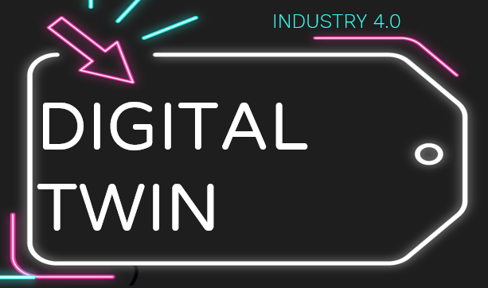


Manthan Dhisale
(193109014)
Zeba Malik
(19300075)
Chinmay VG
(193109018)

Slide 2





INTRODUCTION
DATA BASED
DIGITAL TWIN………………..
PHYSICS BASED
TWIN DEMO
INDUSTRY 4.0
DIGITAL TWIN
ELEMENTS
Data Based Digital Twin
Physics based Digital Twin
Demo

Slide 3
01
DIGITAL TWIN
A Part of Industry 4.0

Slide 4

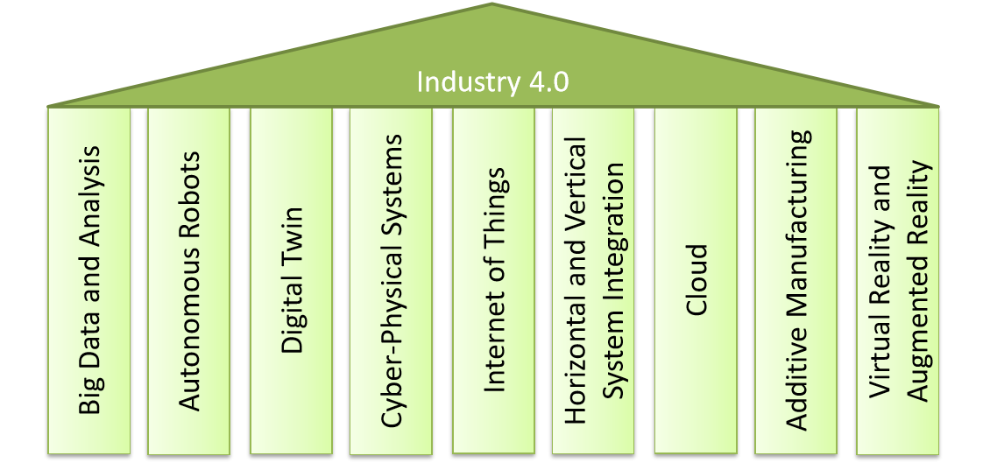
INDUSTRY 4.0 & IT’S COMPONENTS

Slide 5

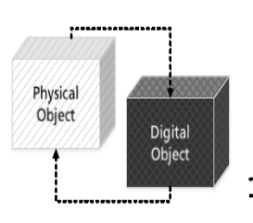
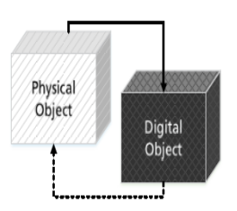
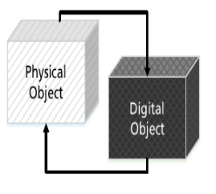
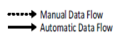
Digital Model
Digital Shadow
Digital Twin
LEVEL OF INTEGRATION

Slide 6
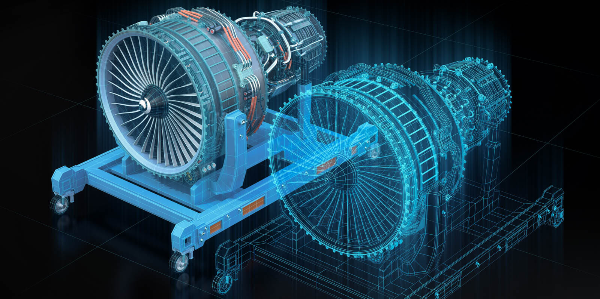

DIGITAL TWIN
Digital twin is an integrated multi-physics, multi-scale, probabilistic simulation of complex product and uses the best available physical models, data model, sensor update, etc. to mirror the life of its corresponding twin.

Slide 7





SENSORS

Slide 8
DIFFERENT TYPES:
Smart sensors
Virtual sensors

Slide 9

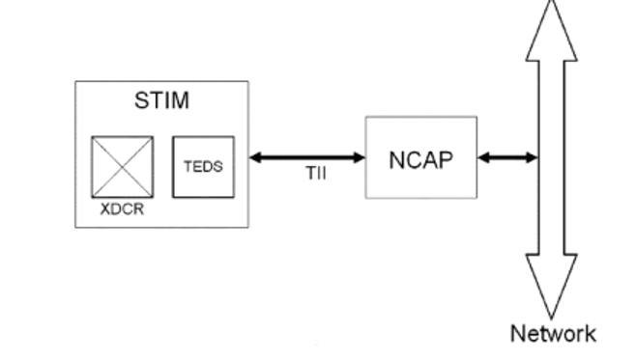
Smart Sensors
Sensor which consist of transducer which convert physical quantity into corresponding signal.

Slide 10

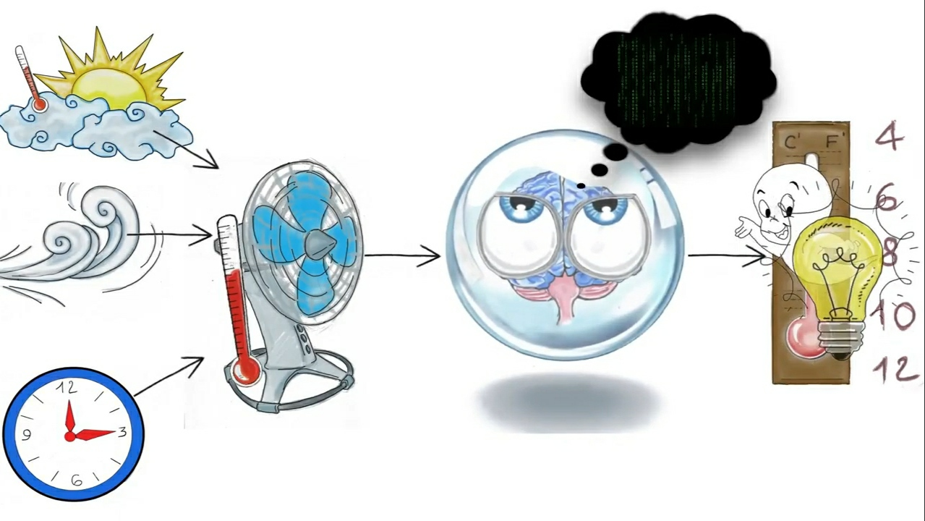
Virtual Sensors
Virtual sensor is a combination of real sensor along with model.
It senses data from real physical sensor and use it as input to a model

Slide 11
02
Physics Based Digital Twin

Slide 12
Role of Physics based Model
Analyze and optimize the performance of products in real-world operating conditions.

Slide 13

PHYSICS BASED EVALUATIONS
Evaluate complex physics that are impossible to fully understand through physical testing
Simulate the product’s field performance in real-time using the same sensor information that the physical asset is experiencing
Data from sensors connected to product or process are used to provide real-time boundary conditions
Help in modifications into the simulation model
Predict about future performance to improve product operation and productivity
Increase Efficiency of product
Reduce the cost and risk of unplanned downtime

Slide 14

Fluid Dynamics
Structural Mechanics
PHYSICS BASED SIMULATIONS CONSIDER
Thermo-dynamics
Newtonian Equations
etc

Slide 15
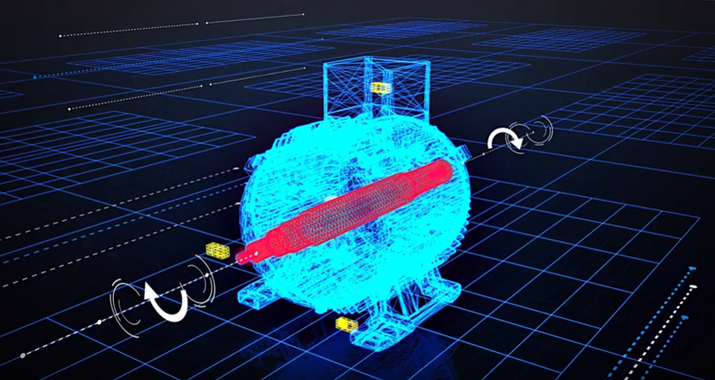
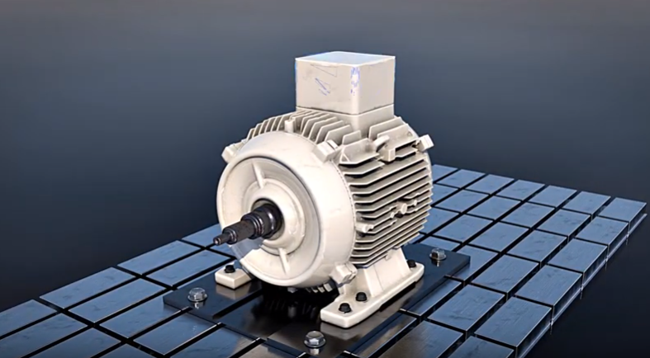
Example

Slide 16
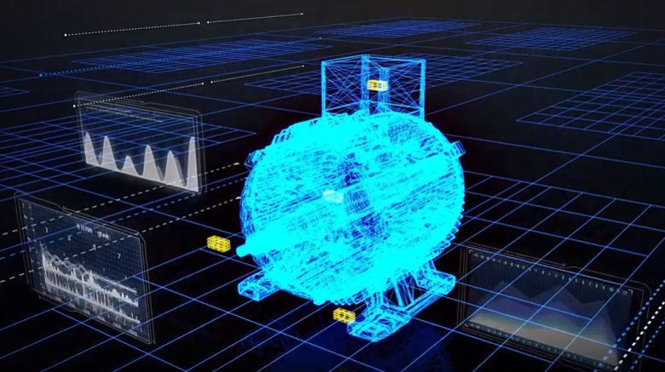
Simulation
https://www.youtube.com/watch?v=ObGhB9CCHP8

Slide 17

User Cases
Data definition
Algorithm
ANALYTICS SOLUTIONS
Implementation
Fill Data lake
3-10 Years
Modelling
Product

Slide 18
User Cases
Data definition
Algorithm
PHYSICS BASED SOLUTIONS
Generate Data
Generate data via simulation (weeks)
Modelling
Implementation
Product

Slide 19


“the digital twin is not a generic model. It’s a collection of actual physics-based models reflecting the exact operating conditions, such as lifing, performance and failure modes, in the real world.”
-Ganesh Bell
Chief digital officer of software and analytics at GE Power and Water

Slide 20
03
DATA BASED DIGITAL TWIN MODEL

Slide 21

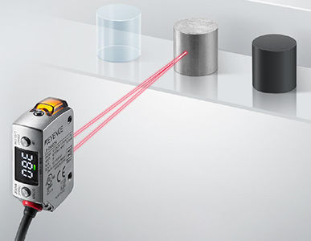
DATA DRIVEN MODELS
LASER DISPLACEMENT
SENSOR
https://www.google.com/url?sa=i&url=https%3A%2F%2Fwww.directindustry.com%2Fprod%2Fkeyence%2Fproduct-

Slide 22
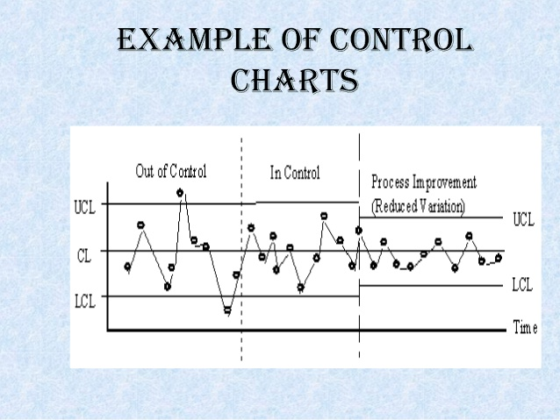
DATA DRIVEN MODELS
SPC IN
PRODUCTION
https://www.google.com/url?sa=i&url=https%3A%2F%2Fasq.org%2Fquality-resources%2Fcontrol

Slide 23
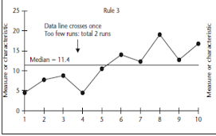
DATA DRIVEN MODELS
SPECIAL CAUSES MONITORING
https://www.google.com/url?sa=i&url=https%3A%2F%2Fasq.org%2Fquality-resources%2Fcontrol456

Slide 24
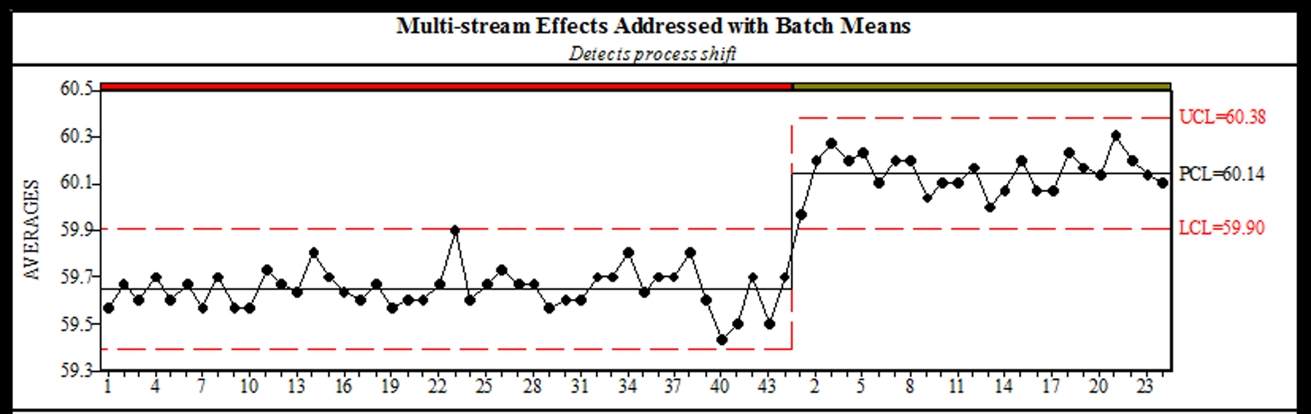
DATA DRIVEN MODELS
CALIBRATION ERRORS
https://www.google.com/url?sa=i&url=https%3A%2F%2Fasq.org%2Fquality-resources%2Fcontrol-chart&psig=AOvVaw2WCWdMGBkRjuhJZU0xxpML&u

Slide 25

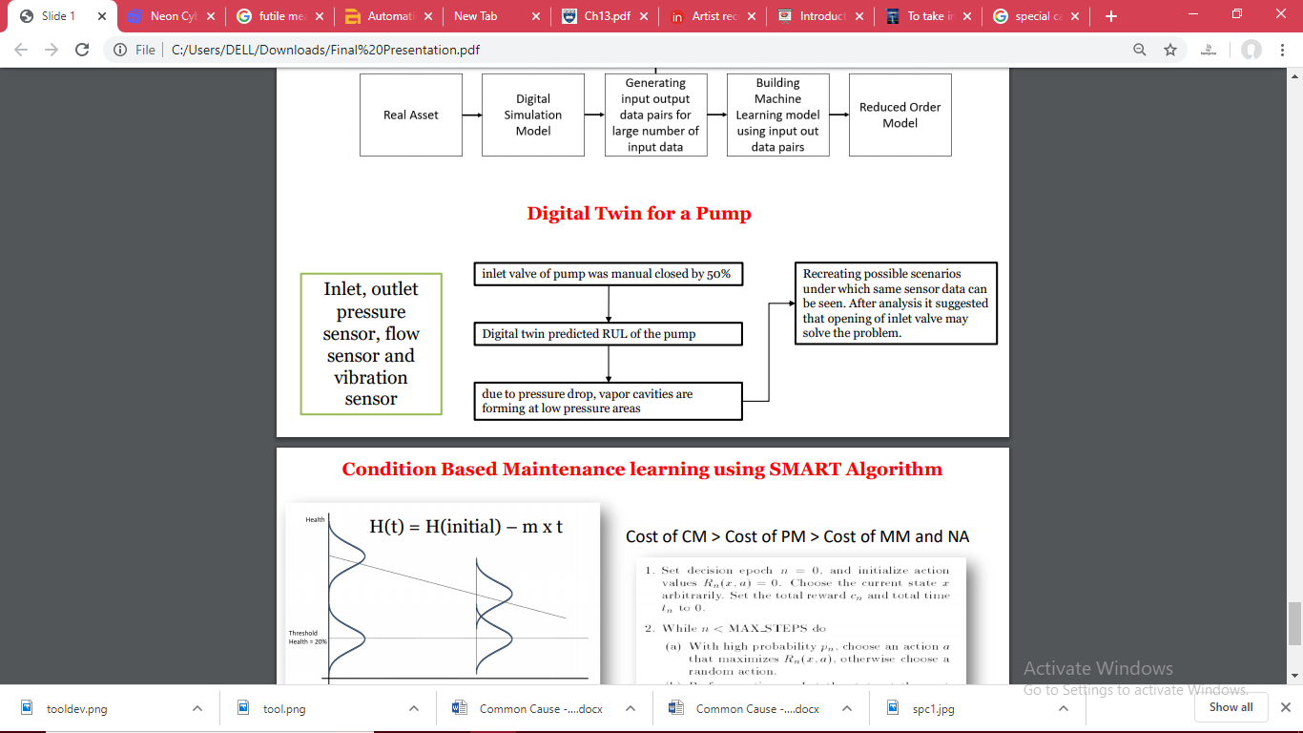
DIGITAL TWIN OF PUMP
M. K. G. T. J. H. W. S. Werner Kritzinger, “Digital Twin in manufacturing: A categorical literature reviewand classification,” IFAC PapersOnLine, Vols. 55-11, pp. 1016-1022, 2018.

Slide 26
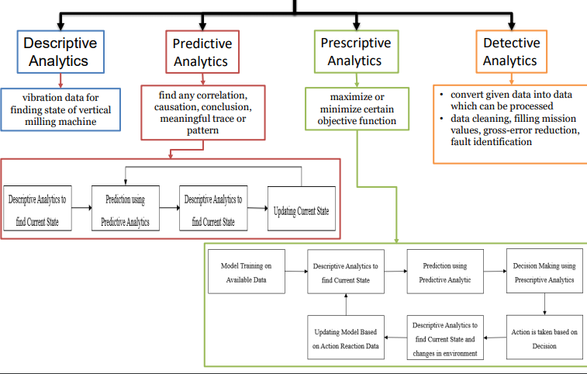
ANALYTICS
Do you know what helps you make your point clear? Lists like this one:
They’re simple
You can organize your ideas clearly
You’ll never forget to buy milk!
And the most important thing: the audience won’t miss the point of your presentation
M. K. G. T. J. H. W. S. Werner Kritzinger, “Digital Twin in manufacturing: A categorical literature reviewand classification,” IFAC PapersOnLine, Vols. 55-11, pp. 1016-1022, 2018.

Slide 27
REFERENCES
Methodology for enabling Digital Twin using advanced physics-based modelling in predictive maintenance Procedia CIRP vol 81,2 019, 417-422
https://www.ansys.com/-/media/ansys/corporate/resourcelibrary/article/ansys-advantage-best-of-high-tech-aa-2018.pdf
https://www.ansys.com/-/media/ansys/corporate/resourcelibrary/article/simulation-for-the-digital-twin-ecosystem-aa-v11-i1.pdf
Merging Physics, Big Data Analytics and Simulation for the Next-Generation Digital Twins
The use of Physics Based Predictive Analytics in Digital Twins Frode Halvorsen, PhD Vice President Technology
https://www.ansys.com/blog/digitalization-needs-physics-based-simulation

Slide 28
DIGITAL TWIN DEMO

Slide 29
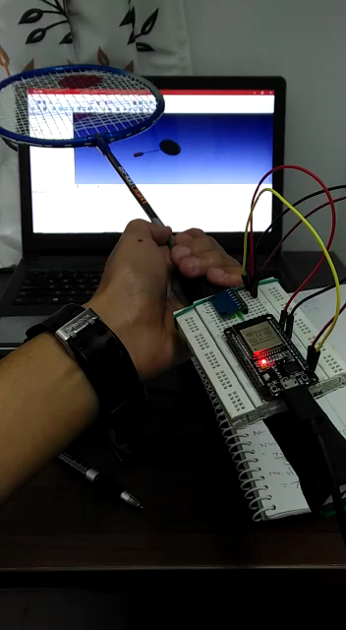
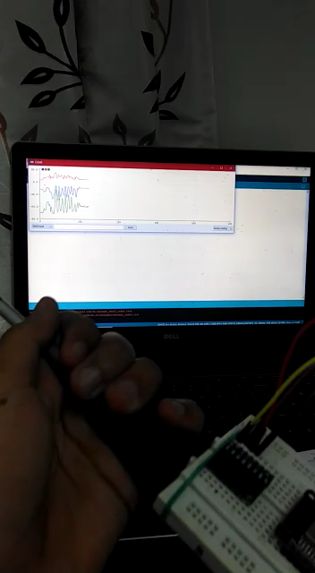

Slide 30
Thank You !

